Slide 1

Amazon Alexa
@ Treasury Board of Canada Secretariat
Pascal Chahine, ISED Ainsley Bernard, TC Lisa Cormier, TC Zachary Falsetto, TC
April 11, 2019

Slide 2

Topics
What is Amazon Alexa?
What is an Alexa Skill?
#TBS #Alexa-Skills
Building a skill that works!
Want to learn more?

Slide 3
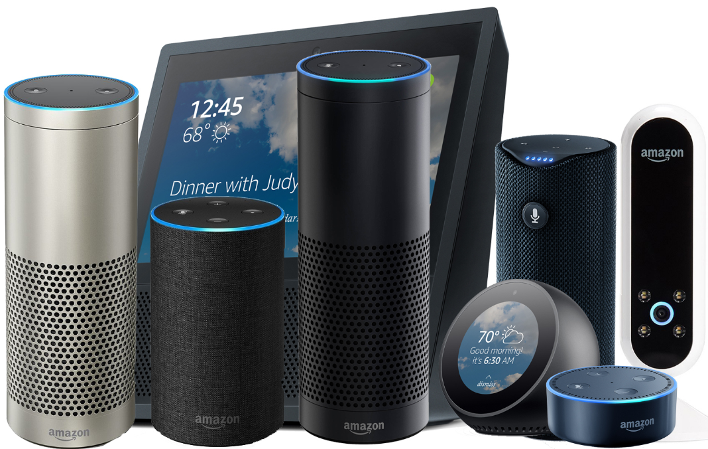
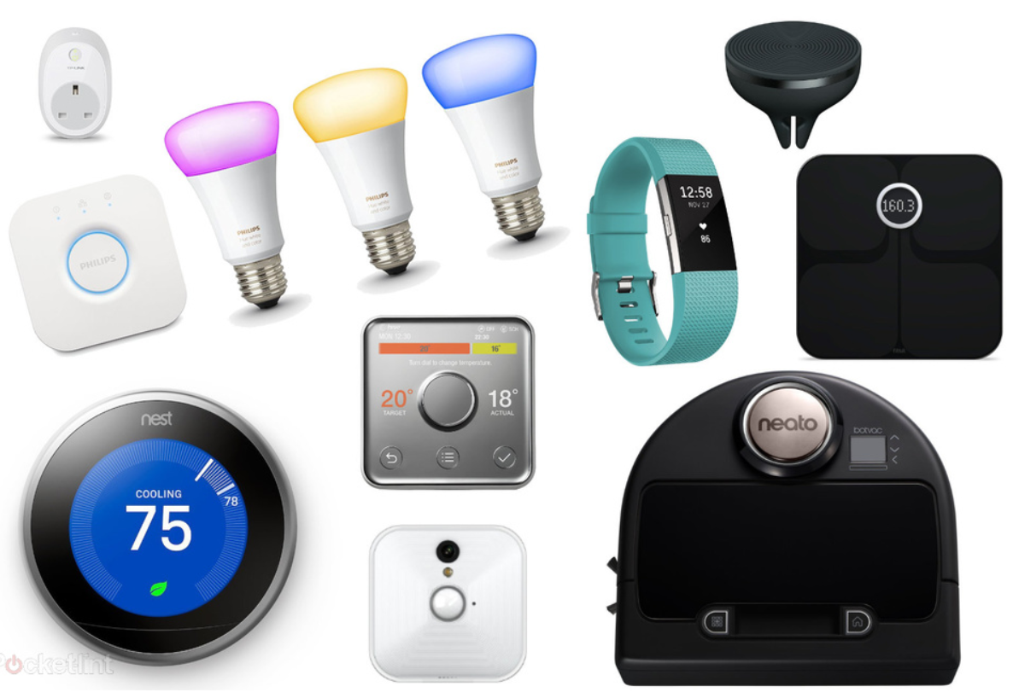
Amazon Alexa
^{Personal assistant from Amazon}
^{Integrated in Smart Speakers} and can be installed on your smartphone
Interfaces with Smart Home Devices
^{Offers convenience} ^{and improves accessibility}

Slide 4
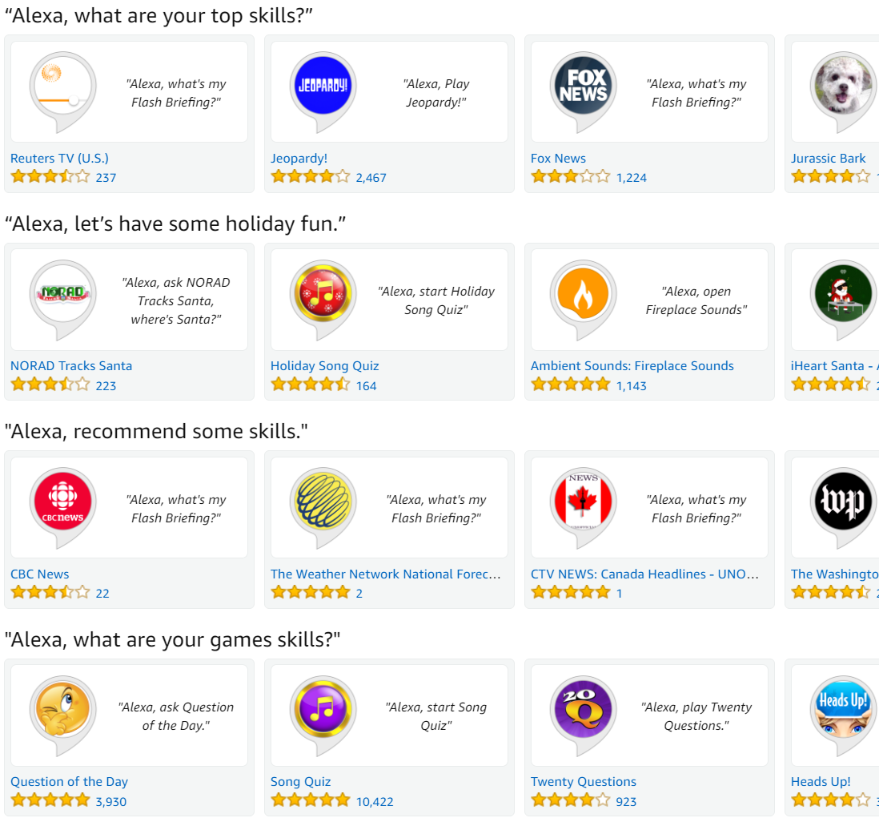
Alexa Skills
Alexa is good at weather updates ^{and play music}
Alexa comes with its own app store
^{Alexa apps are called Skills}
And there are more than 40,000 Skills

Slide 5
#TBS #Alexa-Skills
OneGC organized a 2-week challenge in July 2018
Bring together the private and public sector
Design & develop proof-of-concepts of voice-enabled government services
Learn and share our experience with departments

Slide 6
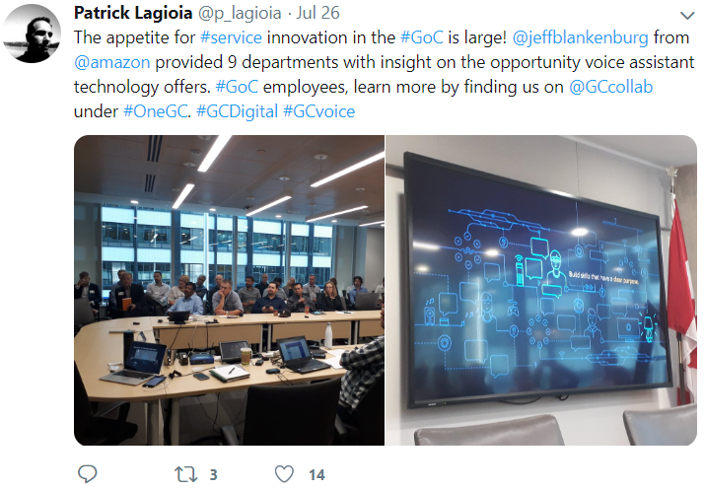
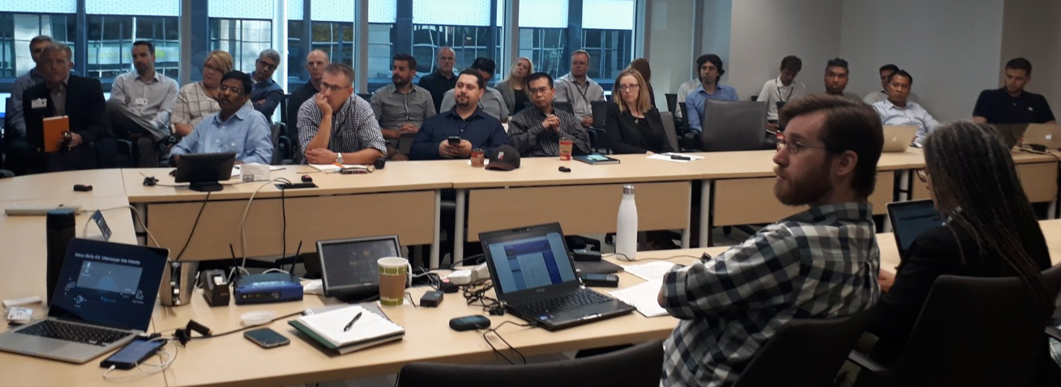
Thank you Amazon! For the 2 full days of seminars on AWS Cloud and Alexa-Skills
Notes:
Ray Hession, AWS Public Sector, Canada

Slide 7
#TBS #Alexa-Skills #Win
6 developers from 4 departments
Transport Canada
Health Canada
Canada Revenue Agency
Innovation, Science and Economic Development Canada
Learned to
Design engaging conversations
Prepare and clean the data
Code and deploy Alexa-Skills on Amazon AWS Cloud
All in the Open using GitHub, Twitter and YouTube

Slide 8
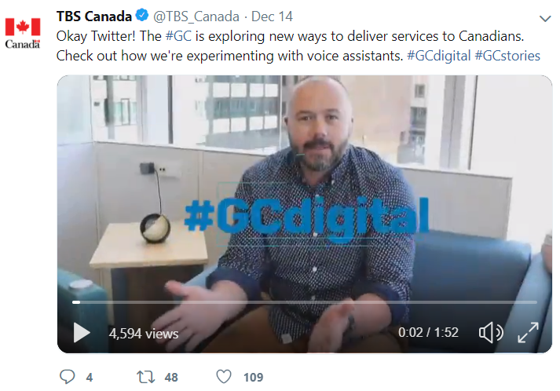

TBS Public Announcement (roll the video)

Slide 9
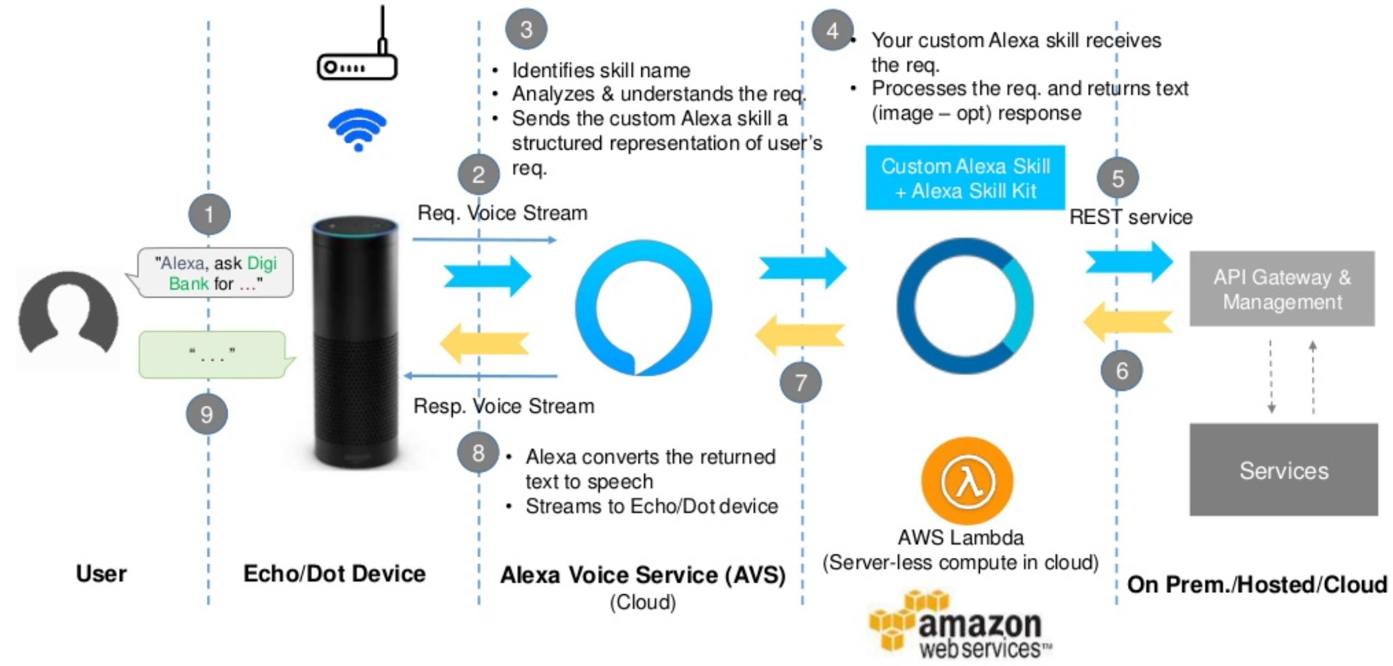


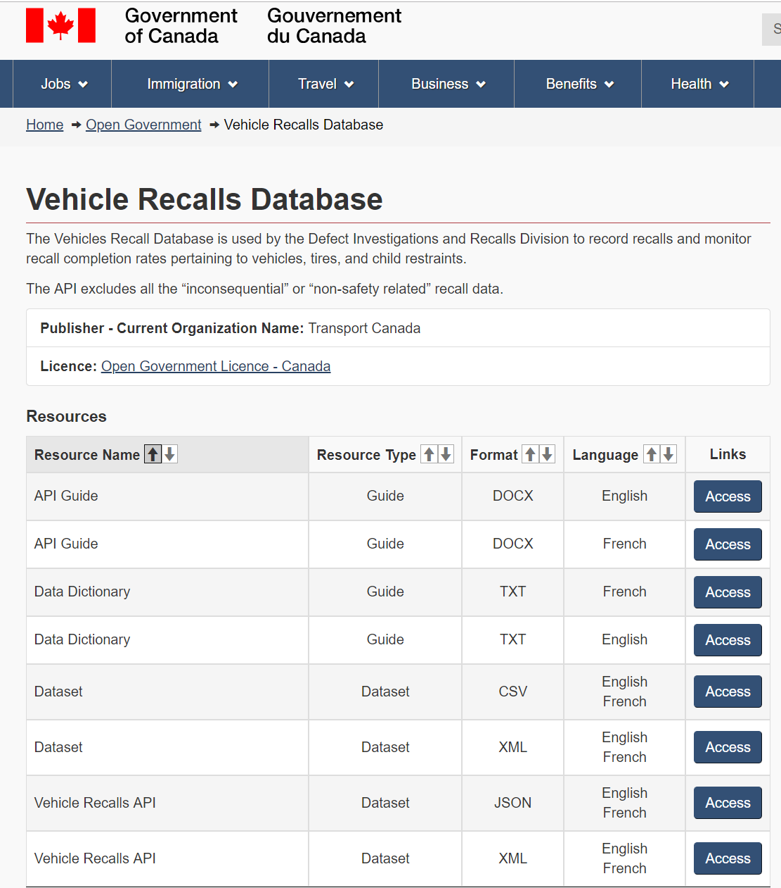
Transport Canada: Sequence Diagram

Slide 10
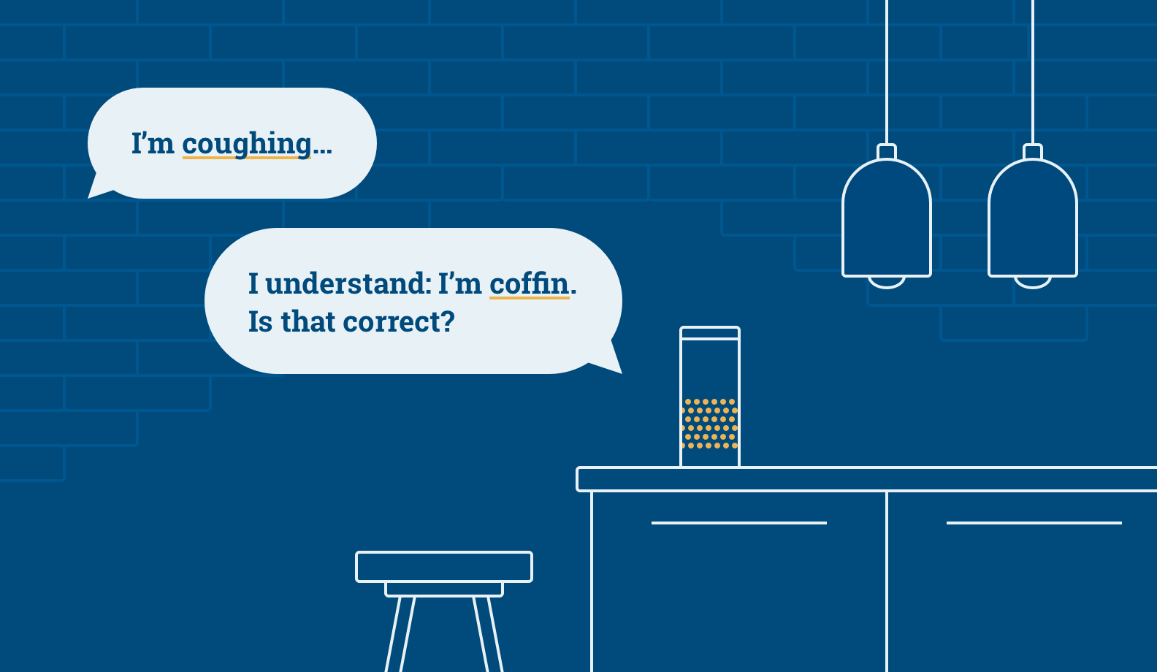
Building a skill that works!

Slide 11
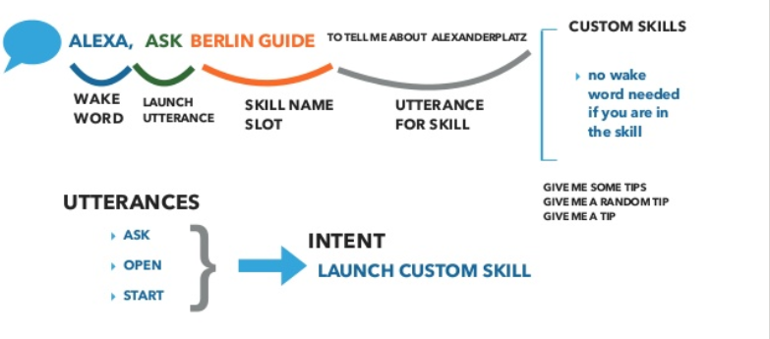
Invocation Name, Intent and Slots

Slide 12
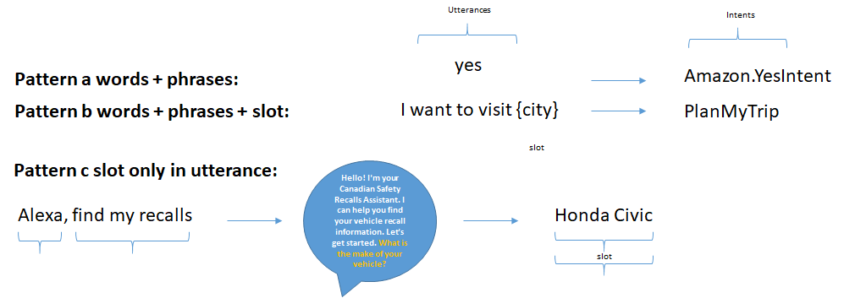
Examples of possible different utterances

Slide 13
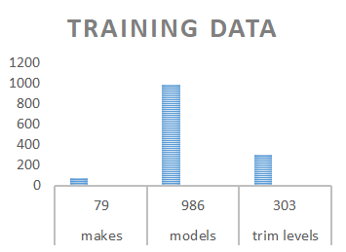
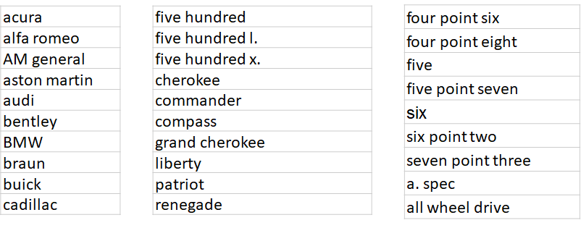
Training data
Make
Model
Trim Level

Slide 14
How the Alexa Engine works
Alexa’s Automatic speech recognition (ASR) and Natural-language understanding (NLU) engines uses
statistical model to select intents and fill slots
What does this mean?
Alexa looks at patterns, frequency, and quantity of values provided to make decisions, i.e. to select intents and fill slots
How does that impact the way we develop for Alexa? A new mental shift, because you really can’t force the AI to do what you
want. But you can influence it.
How do we influence Alexa? Through data or what is called “training data”
•Utterances
•Slots Types

Slide 15
Insights
Goal: user can provide all info upfront or bits information to Alexa
Alexa: What vehicle do you drive?
User: “Honda Civic SI 2017”, “Honda”, “Civic” “Honda Civic”
Problems
Vast variation of model sub types, i.e. trim levels, civic SI, civic LX, civic EX-L, civic sport
Models not in spoken form i.e. BMW 330 I
Model names are not exclusive to it makes i.e. Mazda 323 versus BMW 323
Slot filling confusion

Slide 16
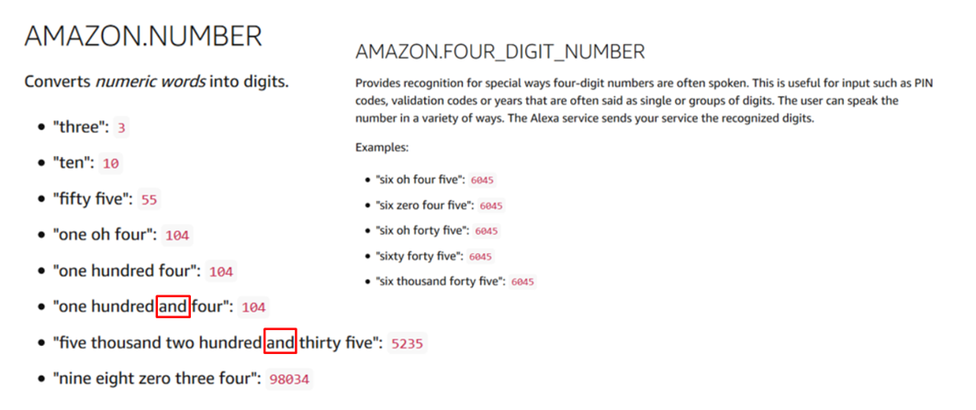
Getting Alexa to understand vehicle year

Slide 17
Slot confusion
User says: “BMW three thirty i”
What Alexa captured:
“BMW three thirty i”
Make: BMW
Model: 3 i
Year: 30

Slide 18
Designing Conversations...
Who are we designing for?
Best practices
for VUI design
Prototyping and testing
How people use voice assistants
How people access vehicle recall information
Voice assistants for accessibility
Making the script conversational
Planning for errors and unexpected utterances
Managing user expectations
Voice-ready data
Prototyping: low fidelity VS high fidelity
Testing: RITE
Next steps
Notes:
Now to go through the User Experience side of our work. We’ll break this down into 3 categories and I’ll take us through the first section: who we are designing for.

Slide 19
How people use voice assistants
Simple tasks, “basic” functions (checking the weather, setting alarms, etc.)
Few users currently use and download Alexa Skills (findability issues, reliance on memory)
Many users experience having to repeat themselves a few times to get their VA to understand their commands
Notes:
Our research has found that people use voice assistants for basic functions, such as “Whats the weather?” “Alexa when will spring come?”
We found that *currently* people rarely download Alexa skills.
People have to repeat themselves. An example one person we tested with explained that they have to repeat themselves 30% of the time.

Slide 20
How people use voice assistants
Sometimes the user shares their VA device with other people (for example, family members)
Some people feel awkward using a voice assistant in public
Many like using voice assistants when their hands are busy (while cooking or driving)
Notes:
4. People share their voice assistant.
5. Some people feel awkward using voice assistants in public. Not a common thing to use voice assistants yet. I agree it is embarrassing.
6. Many people use voice assistants while doing other things, such as working with their hands, such as cooking or driving.

Slide 21
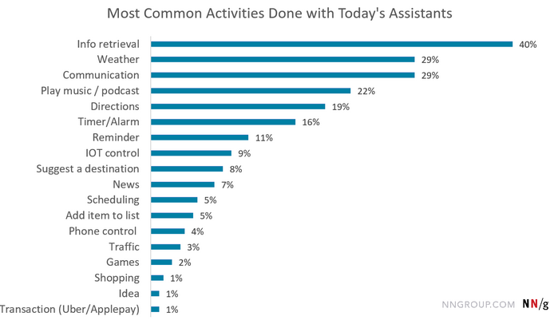
How people use voice assistants
Paradox of Intelligent Assistants: Poor Usability, High Adoption -
Study by Nielsen Norman Group
Notes:
https://www.nngroup.com/articles/intelligent-assistants-poor-usability-high-adoption/
7. Funny enough, voice assistants have poor usability, but high adoption. Heres a breakdown of some of the most common activities.

Slide 22
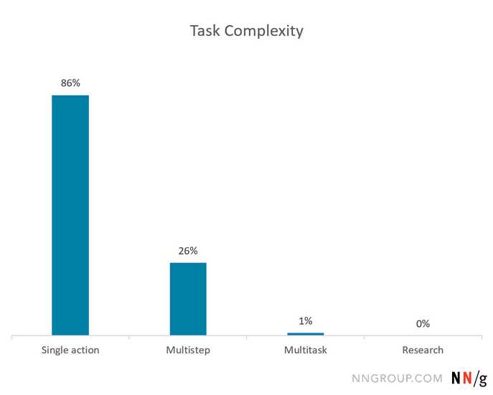
How people use voice assistants
While usability metrics for VAs tend to be poor, VAs still seem to gain popularity because people restrict use to simple tasks
Notes:
https://www.nngroup.com/articles/intelligent-assistants-poor-usability-high-adoption/
8. And based on the tasks people are using voice assistants for, the majority of Alexa skills are single-action. “Whats the weather”.

Slide 23
How people access vehicle
recall information
Most people receive a letter by mail from a manufacturer.
Users typically don’t actively look for vehicle recall information. Many expressed interest in notifications.
They might look for vehicle recall information based on what they hear in the news or social media.
Notes:
Now I’ll go through how people access vehicle recall information.
10. As you might expect, people generally don’t seek out recall information. People mentioned that they might look into recalls if they heard about it on the news or on social media.
11. Generally, they wait until they recieve a letter from the manufacturer.

Slide 24
Voice assistants for accessibility
Opportunities for VAs to help people with some issues (mobility, visual impairment, difficulty reading)
VAs can be challenging for people with speech difficulties, memory issues, or with little access to tech.
VAs can help as an additional channel for a service - but not to replace existing ones.
Notes:
Source: http://intopia.digital/articles/voice-assistants-only-accessible-for-some/
Now I’ll go through the accessibility side of things.
12. Some opportunities we found were with people with

Slide 25
Making the script conversational
Contractions
I have found
VS
I’ve found
Plain language
Alexa: I’ve found a recall potentially affecting your Volkswagen Golf R.
Alexa: I've found a recall that may affect your 2018 Volkswagen Golf R.
Discourse markers
Alexa: Hmm... I've found a few different models of 2018 Volkswagen Golfs.
Alexa: OK. And what is the year of your vehicle?

Slide 26
Making the script conversational
Planning for different responses, contextual, adaptable script
Alexa: What is the make of your vehicle?
User: Honda Civic
Alexa: OK. And what is the year of your vehicle?
Alexa: What is the make of your vehicle?
User: Honda
Alexa: Great. And what is the make of your Honda?
User: Civic
Alexa: Alright. How about the year of your vehicle?

Slide 27
Planning for errors and
unexpected utterances
Progressive reprompts,
Restating the same question with more information
Alexa: What is the make of your vehicle?
User: uhh…
Alexa: What brand makes your vehicle?
more general
more specific

Slide 28

Managing user expectations
Making it clear to the user what the skill can do, especially when handling unexpected requests
Alexa: I'm sorry, I don't have any information on your 2018 Volkswagen Golf R at the moment. I'm still a voice assistant in training.
Please contact my human friends at Transport Canada Recalls customer support at 1-800-333-0510 for more help.
Notes:
https://www.google.com/search?q=student+cartoon&client=firefox-b-ab&tbm=isch&source=iu&ictx=1&fir=sDx4RyGMfXuVjM%253A%252CMY9DJN1vcSTf4M%252C_&vet=1&usg=AI4_-kTxZq9w_vlccnUN7_lx8agz9m8euw&sa=X&ved=2ahUKEwj7hZjtisbhAhUMM6wKHfeUDfsQ9QEwBnoECAYQEA#imgrc=sDx4RyGMfXuVjM:

Slide 29
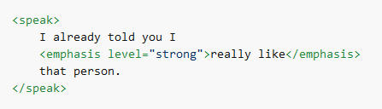
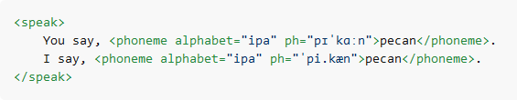
Speech Synthesis Markup
Speech details like pauses, emphasis, phonemes, etc. could make a difference in perceived meaning
Alexa: What is the make of your vehicle?
User: Honda Civic
Alexa: Great! What brand makes your vehicle?
Emphasis level
rate, volume of speech
Phonemes
Recall VS Recall
Provides a phonetic pronunciation
Notes:
Source: https://developer.amazon.com/docs/custom-skills/speech-synthesis-markup-language-ssml-reference.html#ssml-supported

Slide 30
Voice-ready data
Challenge when data is not voice-ready: long text for recalls that we can’t modify (poor listenability)
Solution 1: making sure to add texting or email options to view the information
Solution 2:
Adding commands like “skip” while listening to the long vehicle recall text

Slide 31
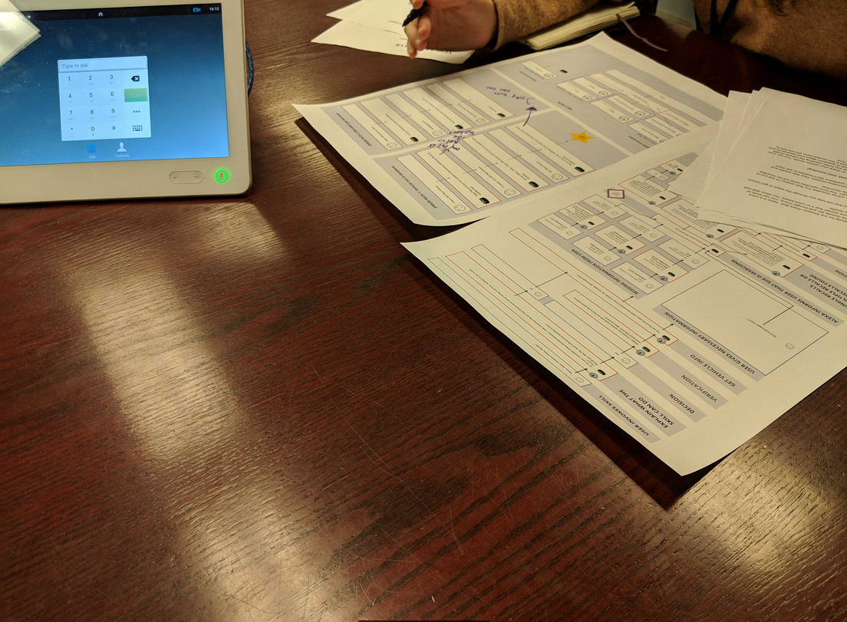
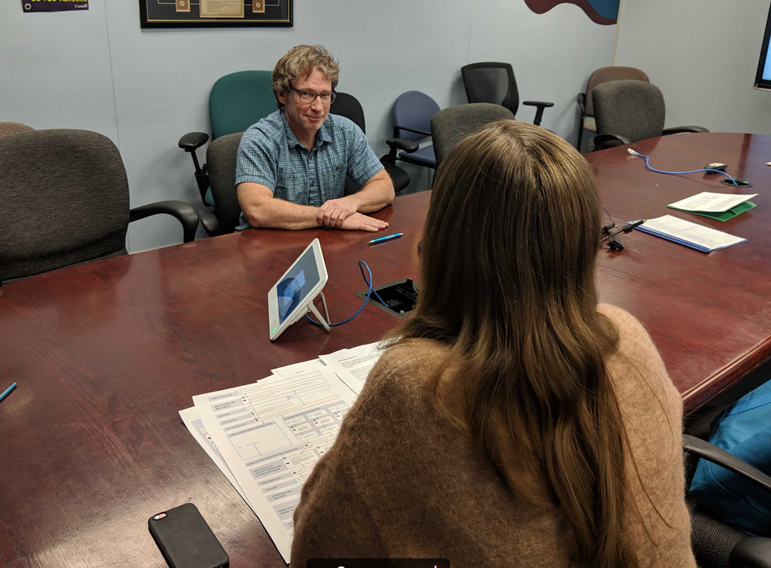
Prototyping: high fidelity VS low fidelity
Keeping the users and their context in mind
Testing with users early (Wizard of Oz, for more contextual fidelity), and then with a functional skill

Slide 32
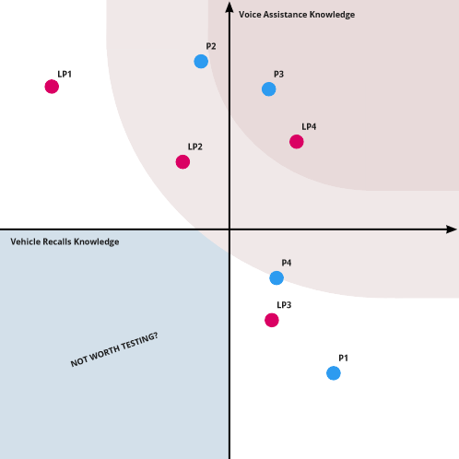
Prototyping: high fidelity VS low fidelity
Choosing criteria to recruit testing participants

Slide 33
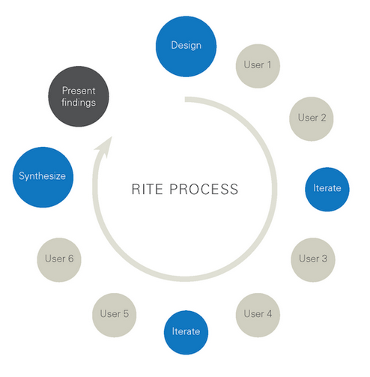
Testing: RITE
Instead of a traditional approach to testing (testing 5-10 users, and then synthesizing results)
For rapid iterative testing and evaluation we make quick iterations after each test.
Notes:
https://medium.com/big-design-magazine/five-ways-to-perform-rapid-usability-testing-faster-7b9a8f3b2897

Slide 34
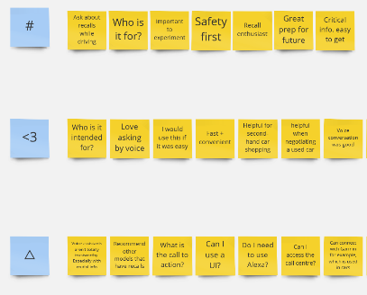
Testing: RITE
Advantages: our team works closely together (allows quick iterations), avoids diminishing returns
Disadvantages: Lack of quantitative data (to see trends or success rates for one version of the skill)
Notes:
https://medium.com/big-design-magazine/five-ways-to-perform-rapid-usability-testing-faster-7b9a8f3b2897

Slide 35
Next Steps
Testing for accessibility - including language variation, “accents”
Quantitative Testing - tracking success rates with the same version of the skill
Post-release testing - higher contextual fidelity
Notes:
https://medium.com/big-design-magazine/five-ways-to-perform-rapid-usability-testing-faster-7b9a8f3b2897

Slide 36
Want to learn more?
Twitter
@MrPascalChahine
@AinsleyBernard2
@LisaUXStories
@zackworkaccount
GitHub
Alexa Transport Canada
TBS Alexa PoC
Notes:
https://medium.com/big-design-magazine/five-ways-to-perform-rapid-usability-testing-faster-7b9a8f3b2897

Slide 38
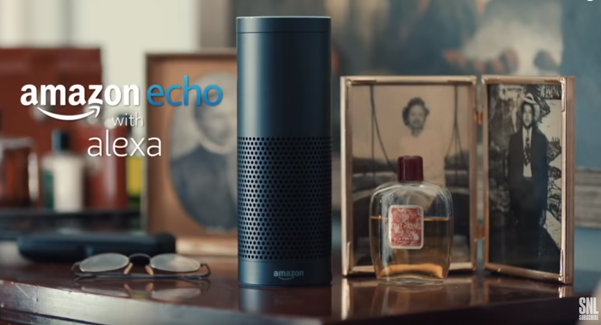
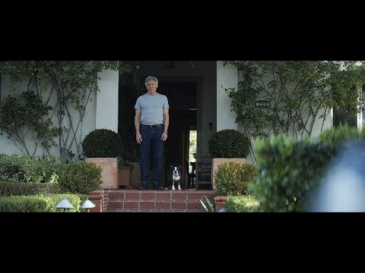

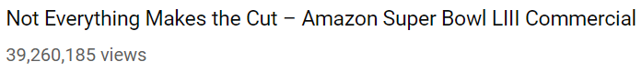
Bonus: Funny Alexa Videos

